Slide 1


Slide 2

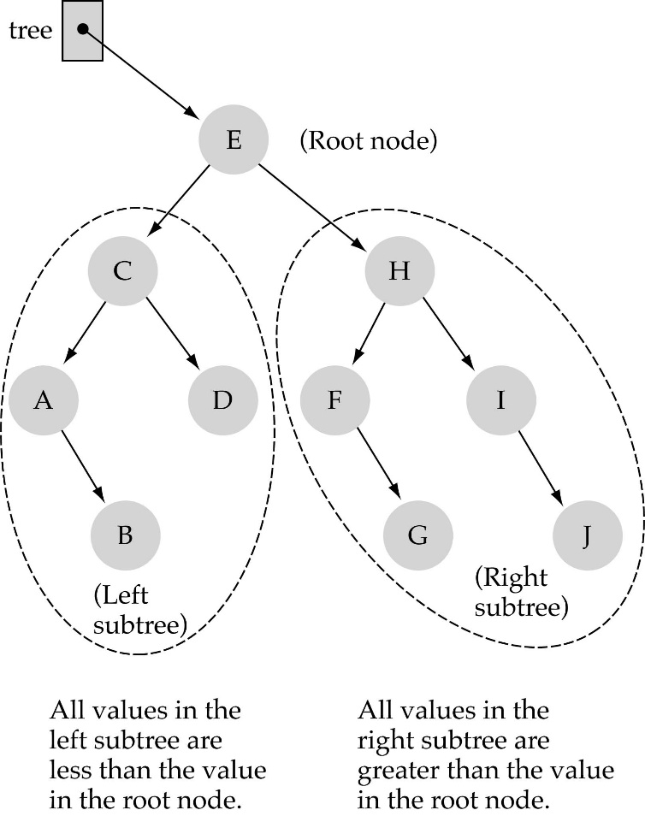
Binary Search Tree Property:
The value stored at
a node is greater than
the value stored at its
left child and less than
the value stored at its
right child

Slide 3

Binary Search Trees (BSTs)
In a BST, the value stored at the root of a subtree is greater than any value in its left subtree and less than any value in its right subtree!

Slide 4
Binary Search Trees (BSTs)
Where is the smallest element?
Ans: leftmost element
Where is the largest element?
Ans: rightmost element

Slide 5


(1) Start at the root
(2) Compare the value of the item you are searching for with the value stored at the root
(3) If the values are equal, then item found; otherwise, if it is a leaf node, then not found

Slide 6
(4) If it is less than the value stored at the root, then search the left subtree
(5) If it is greater than the value stored at the root, then search the right subtree
(6) Repeat steps 2-6 for the root of the subtree chosen in the previous step 4 or 5

Slide 7
Is this better than searching
a linked list?
Yes !! ---> O(logN)

Slide 8

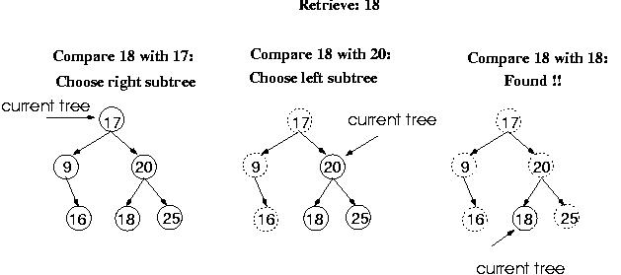

Slide 9
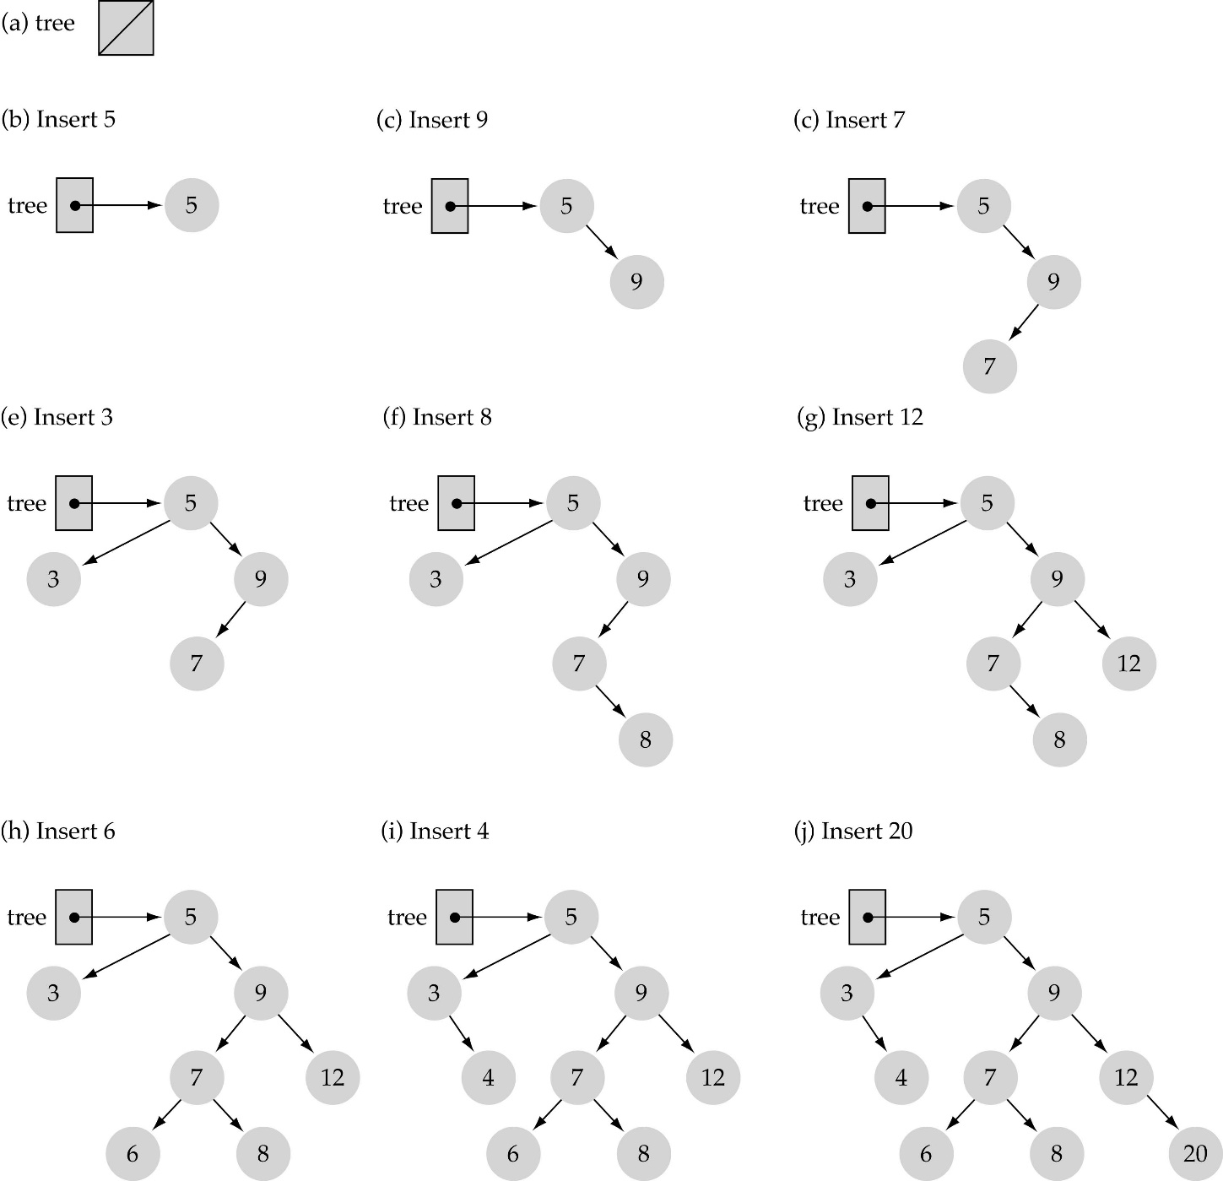

Use the binary search tree property to insert the new item at the correct place

Slide 10
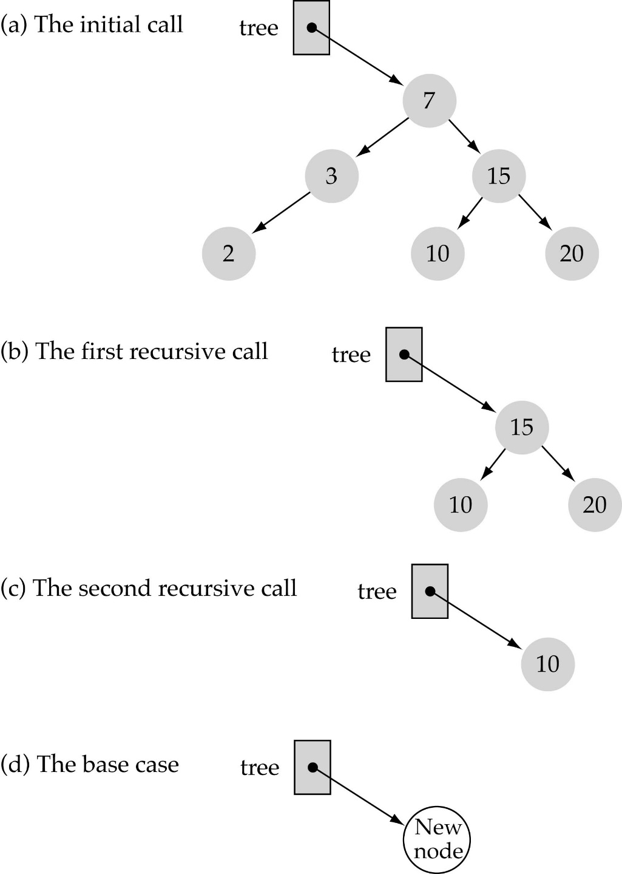
Function InsertItem
(cont.)
Implementing insertion resursively
e.g., insert 11

Slide 11


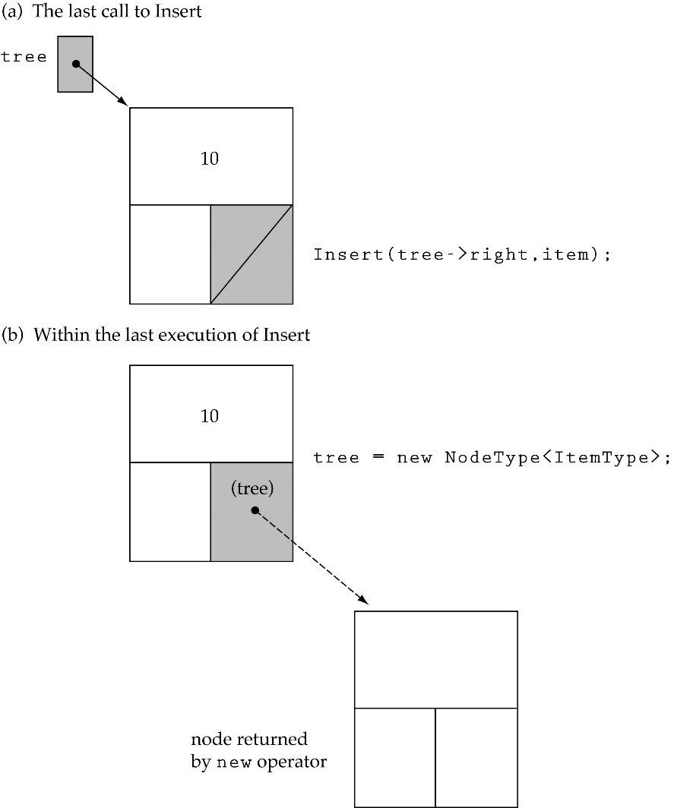
Insert 11

Slide 12

Yes, certain orders might produce very unbalanced trees!

Slide 13
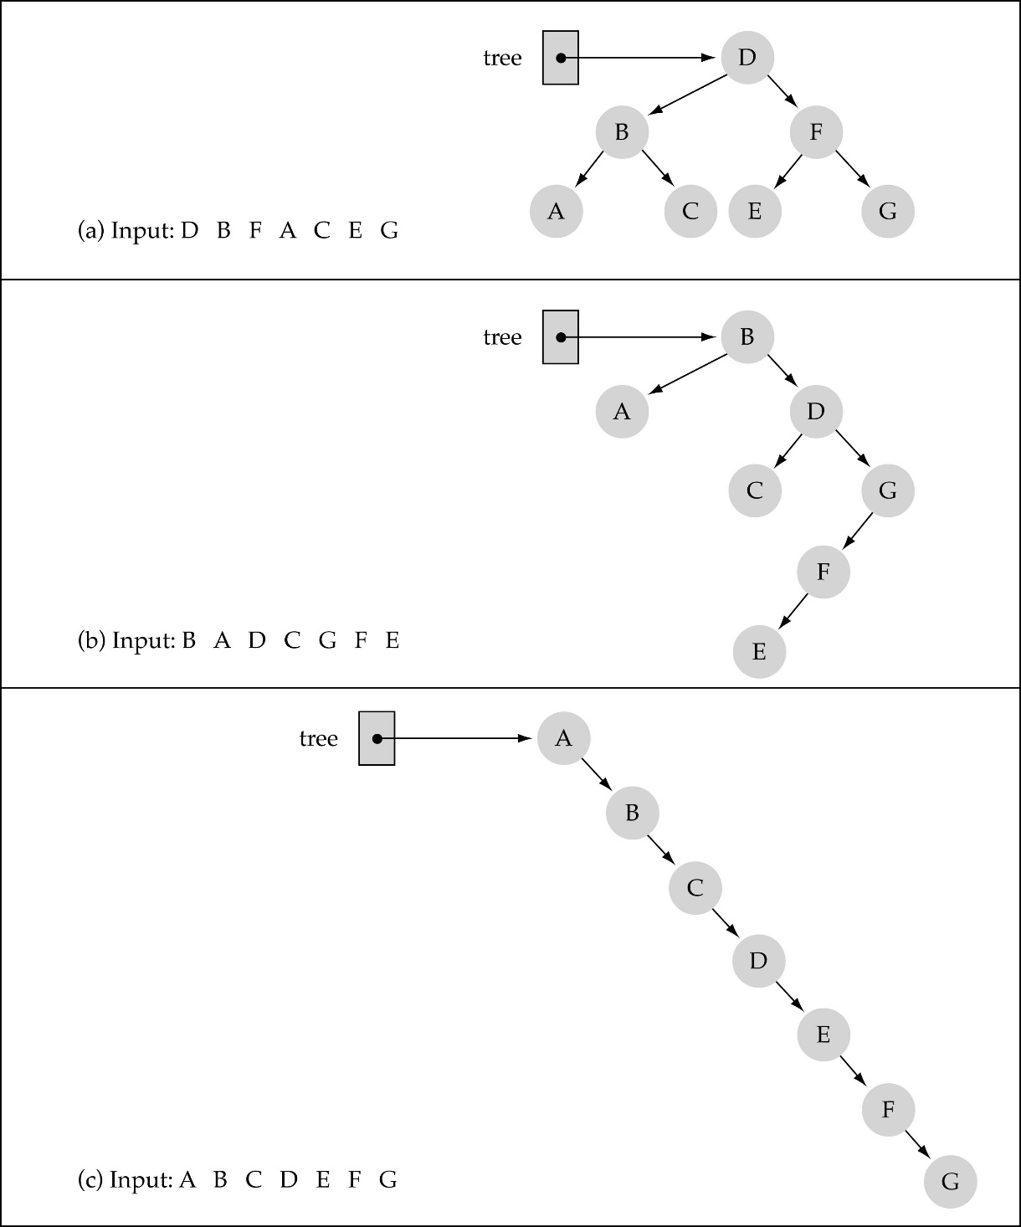
Does the order of inserting elements into a tree matter?
(cont.)

Slide 14
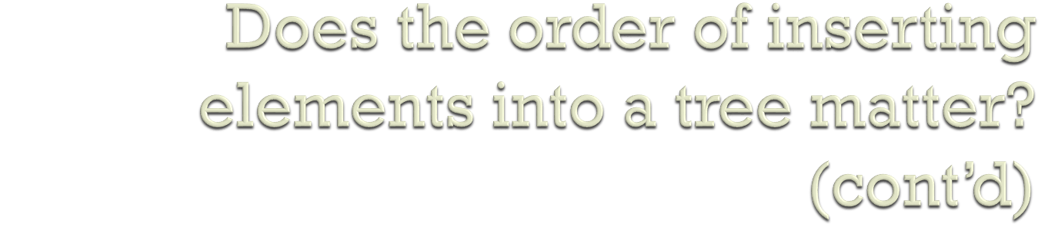
Unbalanced trees are not desirable because search time increases!
Advanced tree structures, such as red-black trees, guarantee balanced trees.

Slide 15

First, find the item; then, delete it
Binary search tree property must be preserved!!
We need to consider three different cases:
(1) Deleting a leaf
(2) Deleting a node with only one child
(3) Deleting a node with two children

Slide 16

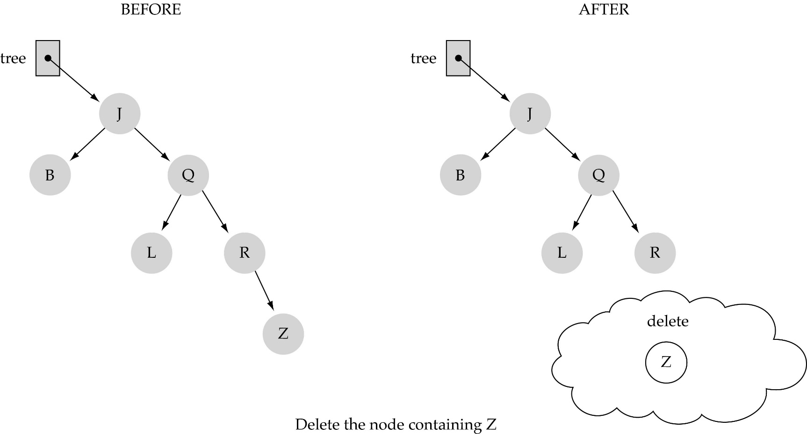

Slide 17
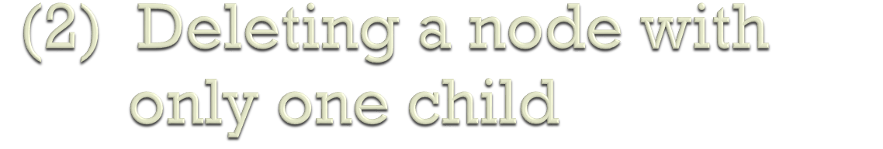
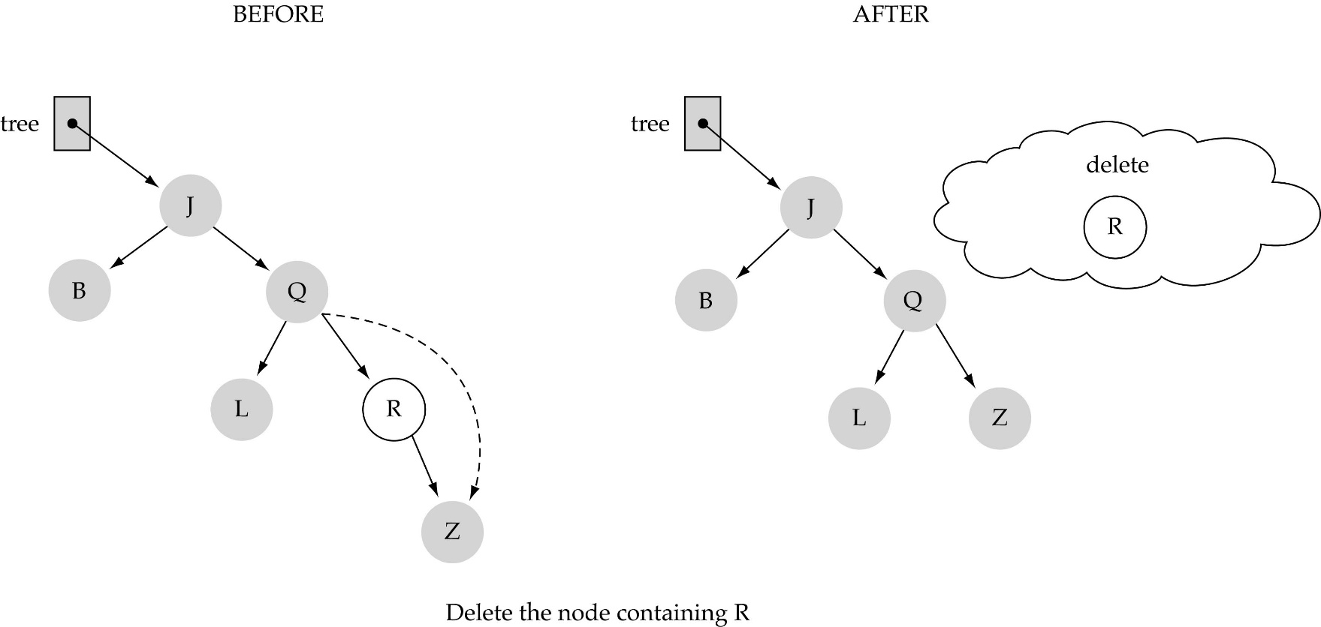

Slide 18
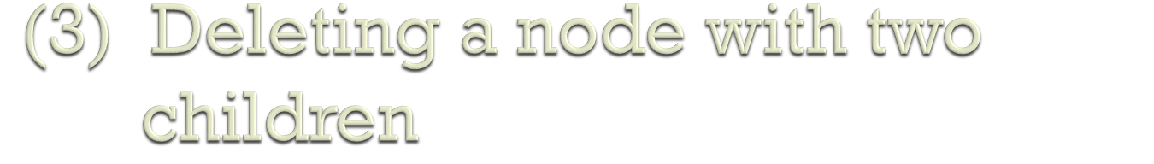
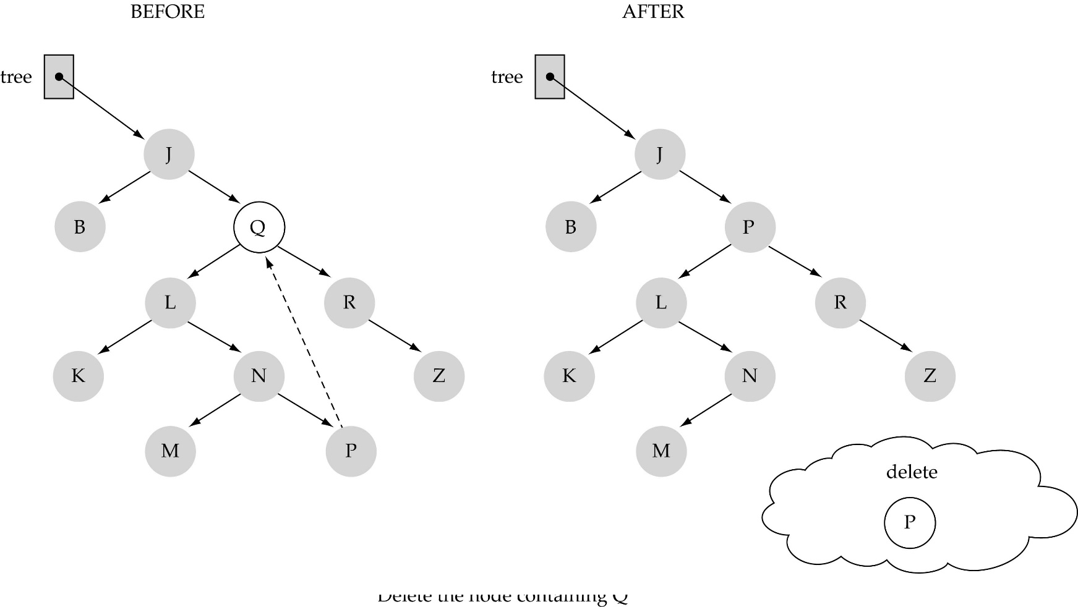

Slide 19
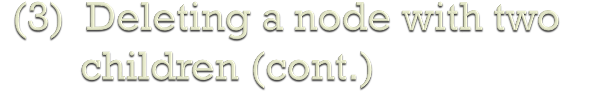
Find predecessor (i.e., rightmost node in the left subtree)
Replace the data of the node to be deleted with predecessor's data
Delete predecessor node

Slide 20
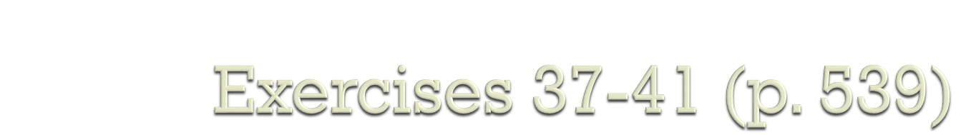
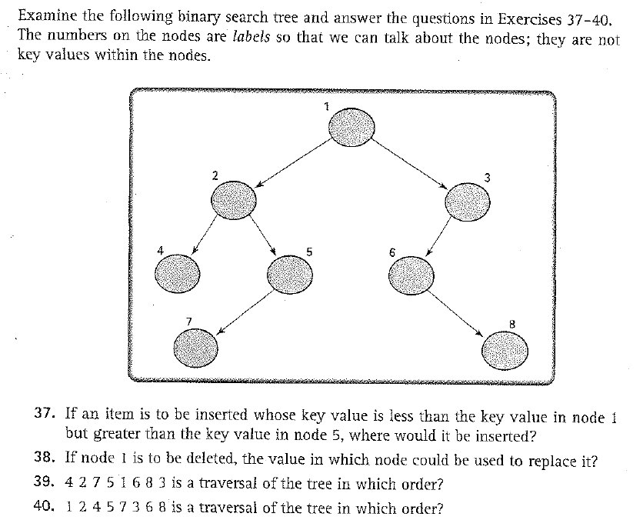

Slide 21
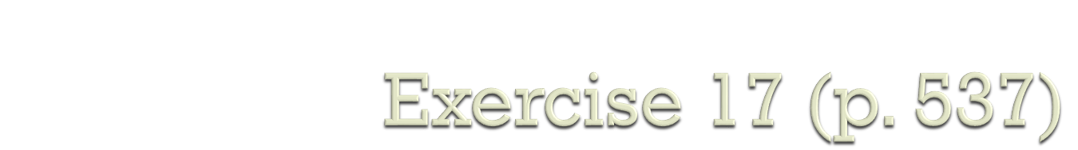
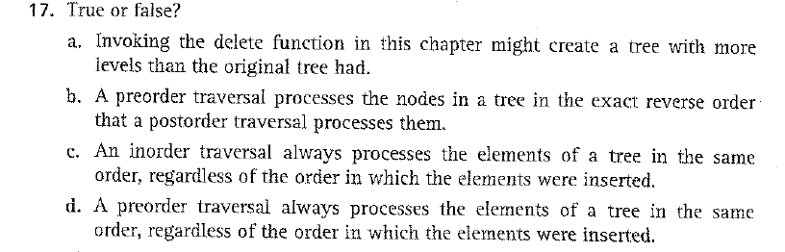

Slide 22
